Slide 1
Knight’s Tour problem

Slide 2
Problem statement
Finding a knight's tour so that it can cover all the positions on chessboard and must not repeat the positions on NxN chessboard.

Slide 3
Data structure used
Array
  That initially stores false value for all unvisited locations
  When a location is gets visited updates value from false to true.

Slide 4
Algorithm
Brute force
Recursion

Slide 5
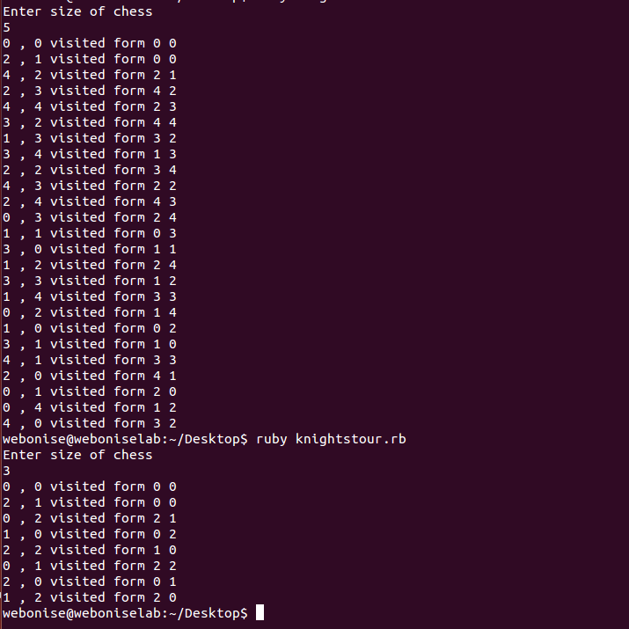
Output

